Slide 1
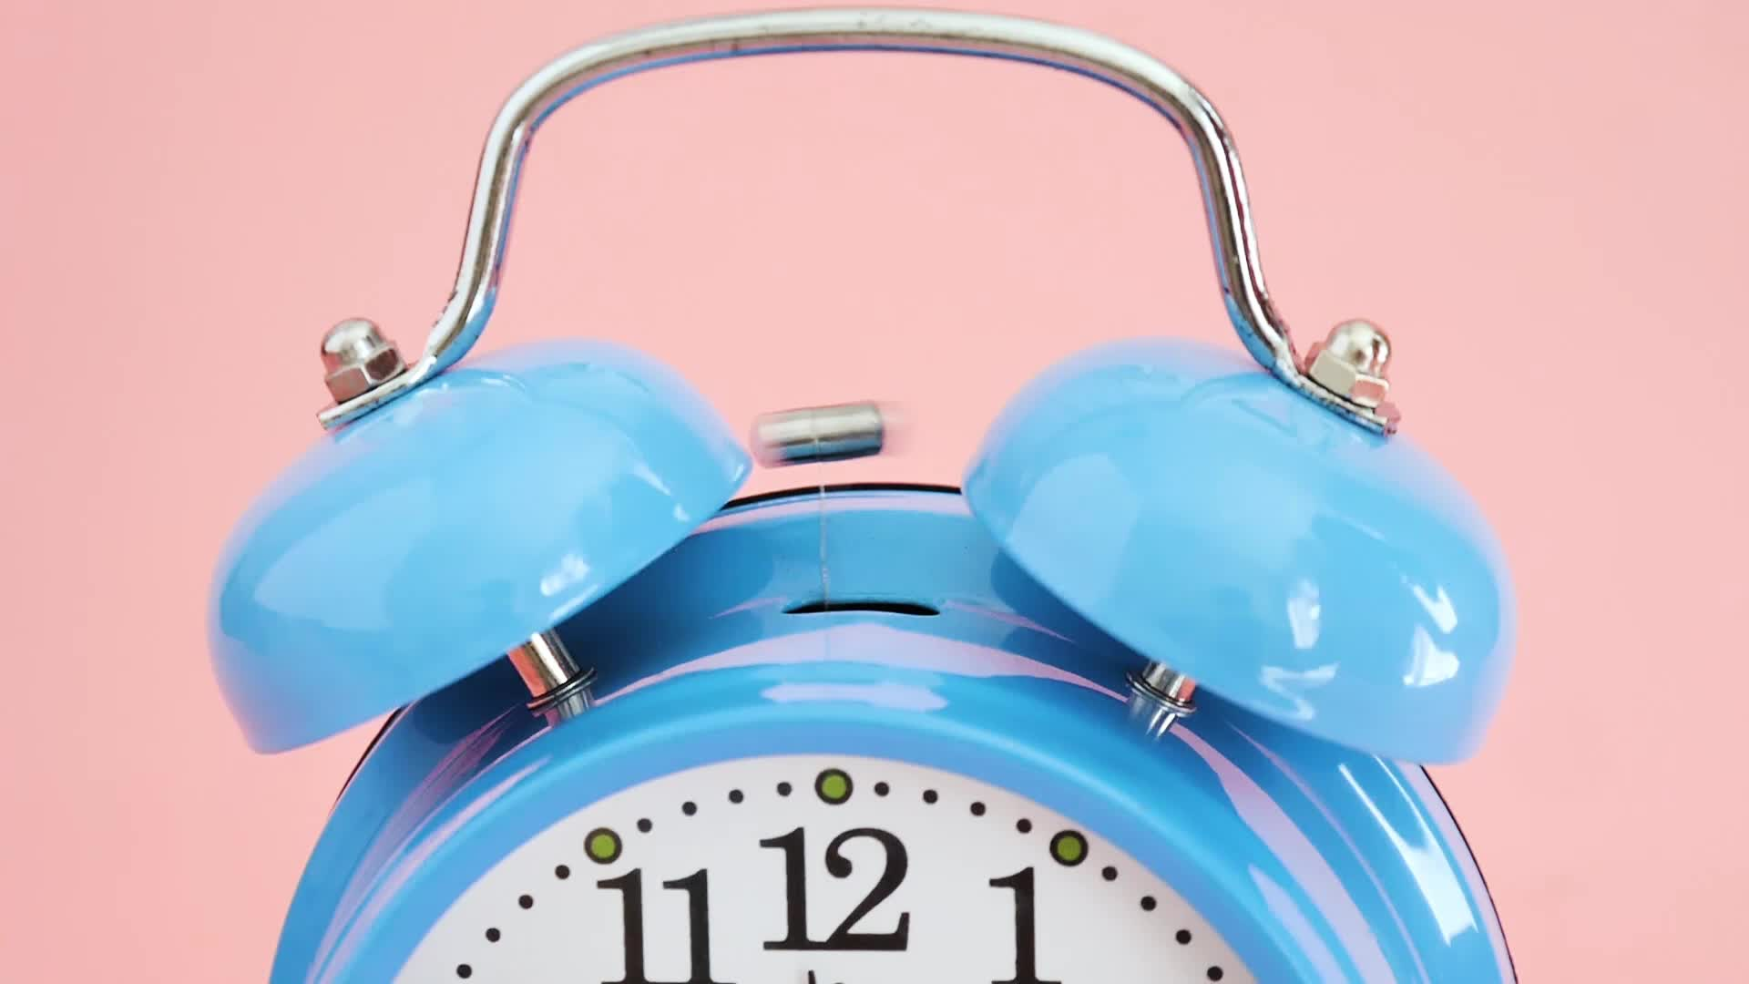
The 9-5 alarm
Using Python programming

Slide 2
INTRODUCTION
Although software engineers who work 9 to 5 receive an amazing pay, they are bound to live in a monotonous work culture. They are glued to their seats and their eyes are fixed on the computer screen constantly exposed to the blue-light display. This takes a toll on their physical health. Working an 8-hour shift can be the cause of dry eyes and back pain - because of staring at the screen continuously for long hours every day whilst having bad posture. Thousands of employees suffer from these symptoms because they tend to neglect their physical wellbeing as they are burdened with a lot of work. However, there is a solution to every problem and for this one –
Ensure to drink plenty of water through the course of the office hours to stay hydrated.
Take a short break every 30 – 45 minutes to look away from the screen and relax your eyes.
Getting off the seat, going for a walk with your colleagues around the block, stretching or even checking on your fellow workers can help you get your mind off work, relaxing your back muscles and maintaining healthy posture.
But we are so engrossed in our work that we forget to make such changes, only if there was a way to remind ourselves at regular intervals of time so that we don’t forget. That is where this program swoops in. It helps create health awareness among people who work at a desk for 8 hours every day. It is user friendly and prompts the user to take a break at regular intervals from their devices

Slide 3



Problem statement of the code :
To create health awareness among people working a job from 9 a.m. to 5 p.m. (or longer).

Slide 4
OBJECTIVES :
1) To prompt users to take a short break from their work instead of working for long hours continuously.
2) To keep and maintain an active log of the user’s activity which is stored permanently on the device and is accessible at the user’s will.

Slide 5

Overview of the program
This code reminds the user to take breaks while working and logs the breaks they take. The program asks for the user's name to create a file in their name, and then offers a menu with options - to start an alarm for taking breaks, open previous activity, and to exit the program.
If the user chooses to start the alarm, they are asked for the time intervals for drinking water and relaxing their eyes. The program then plays an audio file to remind the user to take a break after the specified intervals and logs the break they took. The program will continue to remind the user to take breaks until they exit the program or until it is no longer office hours. If the user chooses to open previous logs, they are given a sub-menu to choose whether they want to view their logs for drinking water breaks, logs for relaxing their eyes, or to exit the sub-menu. If the user chooses to exit the program, the program will end.
Overall, this program is used for reminding people to take breaks while working and keeping track of the breaks they take.

Slide 6

Tools & modules used :
Pygame - Pygame is a Python library designed for creating video games. It provides functionality for creating graphics, handling user input, playing sounds and music, and other features commonly found in video games. Pygame is built on top of the SDL library.
mixer - The Pygame Mixer module is a part of the Pygame library used for loading and playing audio files in different formats like WAV, MP3, OGG, MIDI, etc. It provides functions for loading, playing, pausing, stopping, and fading in/out of audio files. It also allows you to set the volume and channels for each sound.
time – it is a module in Python that provides various time-related functions. It allows you to measure time, sleep for a specific duration, and get the current time in different formats.

Slide 7
SYSTEM REQUIREMENTS -
Operating System: Windows 11/10/8/7 (32-bit or 64-bit)
Software: VS Code (with pygame installed)
*To install pygame, open cmd and type: ‘pip install pygame’, without which the program will not run successfully.
Language used: Python.

Slide 8
references
https://www.geeksforgeeks.org/python-time-module/ - To learn about the time module.
https://www.geeksforgeeks.org/python-playing-audio-file-in-pygame/ - To learn about the pygame library and mixer module.
https://chat.openai.com/ - for error rectification and improvising.
https://www.youtube.com/ - used it for finding audio files and then downloaded it.

Slide 9

THANK YOU!
SUBMITTED BY :
SRUJAN V
SAP ID - 500106950
BATCH - 11

